Slide 1
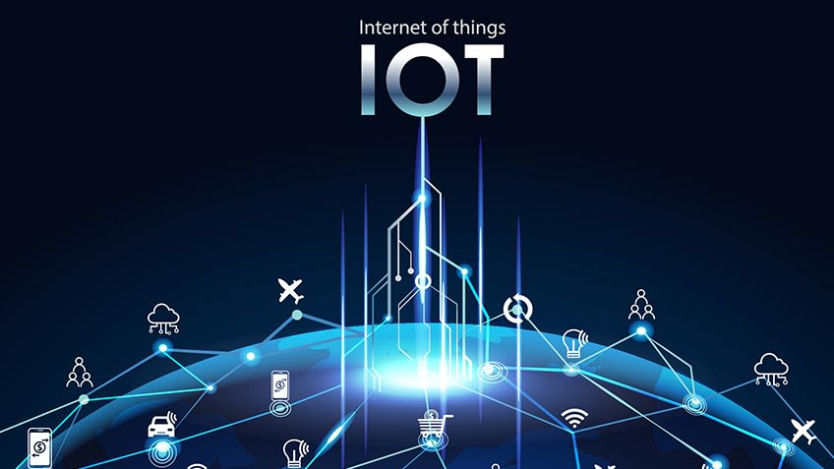



Slide 2

History of IOT
1999- The term "Internet of Things" was used by Kevin Ashton during his work at P&G which became widely accepted
2004 - The term was mentioned in famous publications like the Guardian, Boston Globe, and Scientific American
2005-UN's International Telecommunications Union (ITU) published its first report on this topic.
2008- The Internet of Things was born
2011- Gartner, the market research company, include "The Internet of Things" technology in their research

Slide 3
Current Status & Future Prospect of IoT
“Change is the only thing permanent in this world”

Slide 4
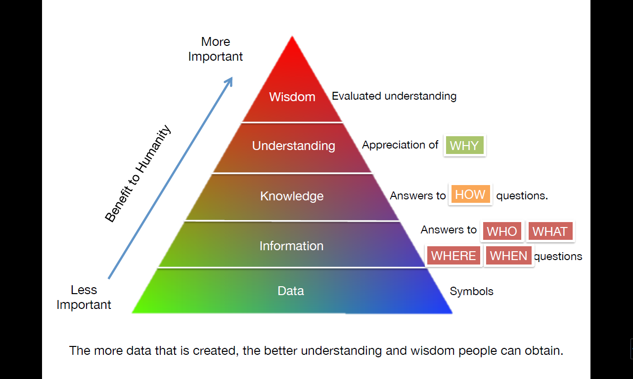
Knowledge Management – Turning Data into Wisdom
The more data that is created, the better understanding and wisdom people can obtain.

Slide 5
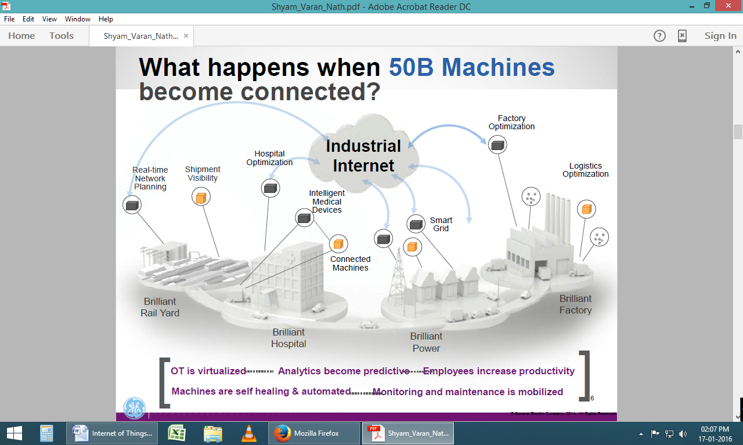
The Future of IoT
"The Sky's not the limit. It's only the beginning with IoT."

Slide 6
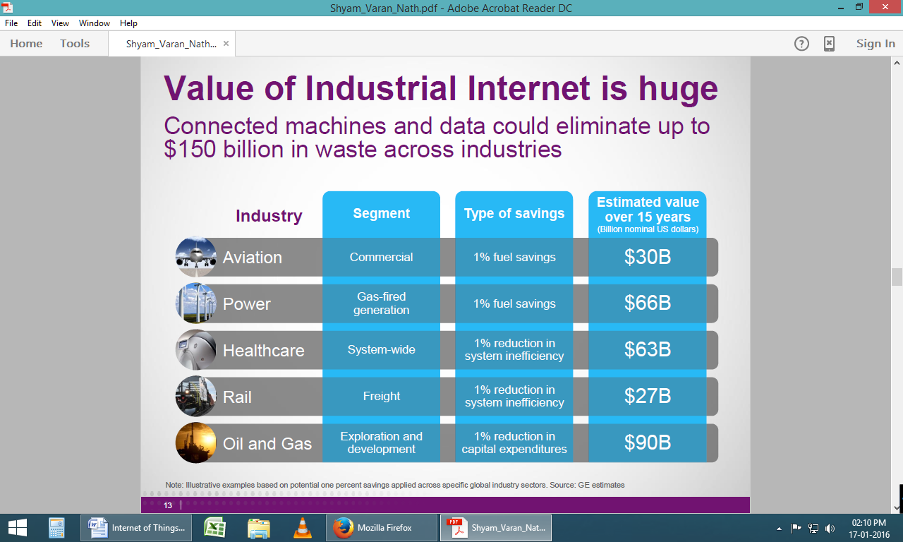
The Potential of IoT
GE’s estimates on potential of just ONE percent savings applied using IoT across global industry sectors.

Slide 7
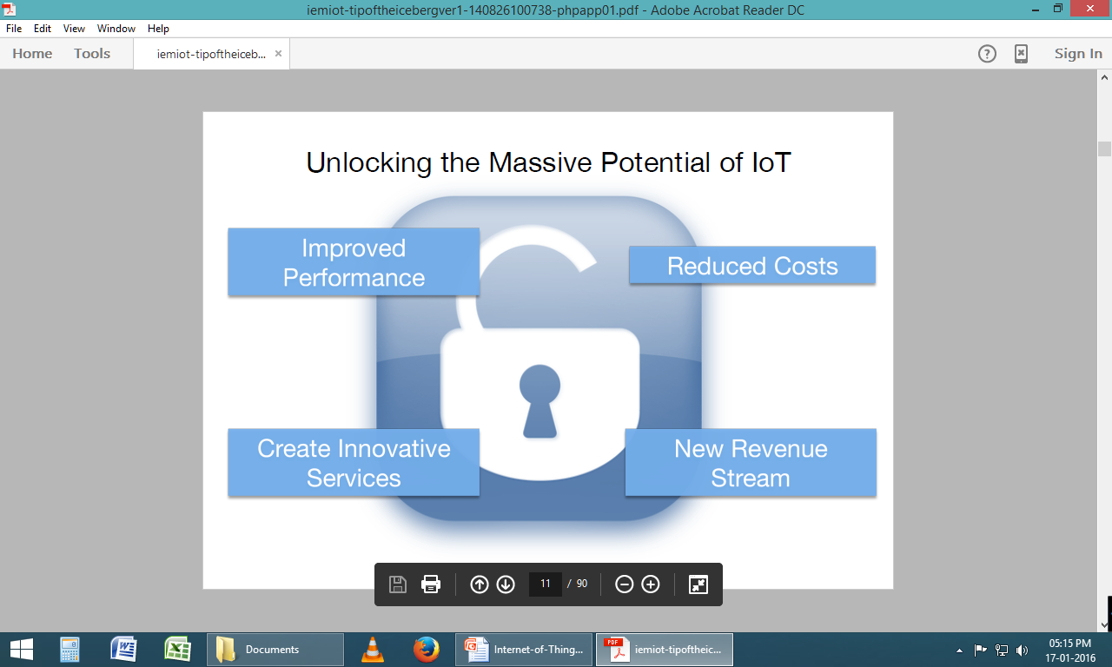
Unlock the Massive potential of IoT

Slide 8
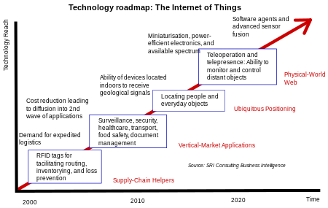
Technology roadmap of IoT

Slide 9
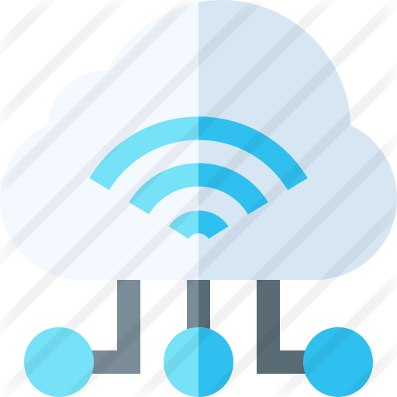
Iot Definition
“The Internet of Things (IoT) is a system of interrelated computing devices, mechanical and digital machines, objects, animals or people that are provided with unique identifiers and the ability to transfer data over a network without requiring human-to-human or human-to-computer interaction.”

Slide 10
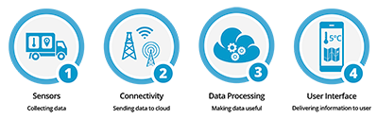
How IoT works?
1) Sensors/Devices
2) Connectivity
3) Data Processing
4)User Interface

Slide 11
How IoT Works?
RFID
Sensor
Smart Tech
Nano Tech
To identify and track the data of things
To collect and process the data to detect the changes in the physical status of things
To enhance the power of the network by devolving processing capabilities to different part of the network.
To make the smaller and smaller things have the ability to connect and interact.

Slide 12

1) Sensors/Devices
Sensors or devices are a key component that helps you to collect live data from the surrounding environment.
All this data may have various levels of complexities.
It could be a simple temperature monitoring sensor, or it may be in the form of the video feed.

Slide 13
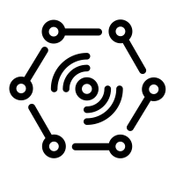
2) Connectivity
All the collected data is sent to a cloud infrastructure.
The sensors should be connected to the cloud using various mediums of communications.
These communication mediums include mobile or satellite networks, Bluetooth, WI-FI, WAN, etc.

Slide 14

3) Data Processing
Once that data is collected, and it gets to the cloud, the software performs processing on the gathered data.
This process can be just checking the temperature, reading on devices like AC or heaters.
However, it can sometimes also be very complex like identifying objects, using computer vision on video.

Slide 15
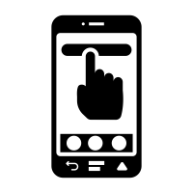
4)User Interface
The information needs to be available to the end-user in some way which can be achieved by triggering alarms on their phones or sending them notification through email or text message.
The user sometimes might need an interface which actively checks their IoT system.
For example, the user has a camera installed in his home. He wants to access video recording and all the feeds with the help of a web server.

Slide 16
What is an example of an Internet of Things device?
A lightbulb that can be switched on using a smartphone app is an IoT device, as is a motion sensor or a smart thermostat in your office or a connected streetlight.
An IoT device could be as fluffy as a child's toy or as serious as a driverless truck.
Some larger objects may themselves be filled with many smaller IoT components, such as a jet engine that's now filled with thousands of sensors collecting and transmitting data back to make sure it is operating efficiently.

Slide 17
IoT benefits to organizations
monitor their overall business processes;
improve the customer experience (CX);
save time and money;
enhance employee productivity;
integrate and adapt business models;
make better business decisions; and
generate more revenue.

Slide 18
Why Is Internet of Things (IoT) so important?
Over the past few years, IoT has become one of the most important technologies of the 21st century.
Now that we can connect everyday objects—kitchen appliances, cars, thermostats, baby monitors—to the internet via embedded devices, seamless communication is possible between people, processes, and things.
By means of low-cost computing, the cloud, big data, analytics, and mobile technologies, physical things can share and collect data with minimal human intervention.

Slide 19
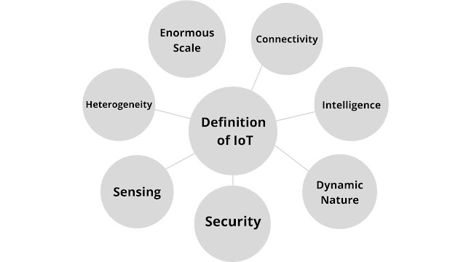
Characteristics of IoT:
Connectivity
Connectivity entitles the internet of things by bringing together everyday objects. With everything in IoT devices and hardware, with sensors and other electronics and connected hardware and control systems there need to be a connection between various levels. It provides hardware accessibility and compatibility in the things with this connectivity, and new market opportunities for the intent of things can be created by the networking of smart appliances.
Intelligence
The Intelligence in IoT is only concerned with the interaction between devices, while user and device interaction is achieved by standard input methods and graphical user interfaces.

Slide 20
Dynamic Nature
The most important part of IoT is gathering data from its environment, which is achieved with the dynamic changes that take place around the devices. In addition to the context of devices including temperature, location, and speed and the number of devices also changes dynamically with a person, place, and time.
Security
IoT devices are vulnerable to security threats. There is a high level of transparency and privacy issues with IoT. For creating a security paradigm, it is important to secure the endpoints, networks, and data that are transferred across all of them.
Sensing
The sensing information is the analog input from the physical world, but it can provide a rich understanding of the complex world.
Heterogeneity
IoT architecture must support direct network connectivity between heterogeneous networks. The requirement of heterogeneous networks in IoT is scalabilities, modularity, extensibility, and interoperability.
Enormous Scale
the enormous scale of IoT in the estimated report where it expressed that 5.5 million new things will get connected every day and 6.4 billion connected devices will be in use worldwide in 2016, which is up by 30% from 2015. The report also forecast that the number of connected devices will reach 20.8 billion by 2020.

Slide 21
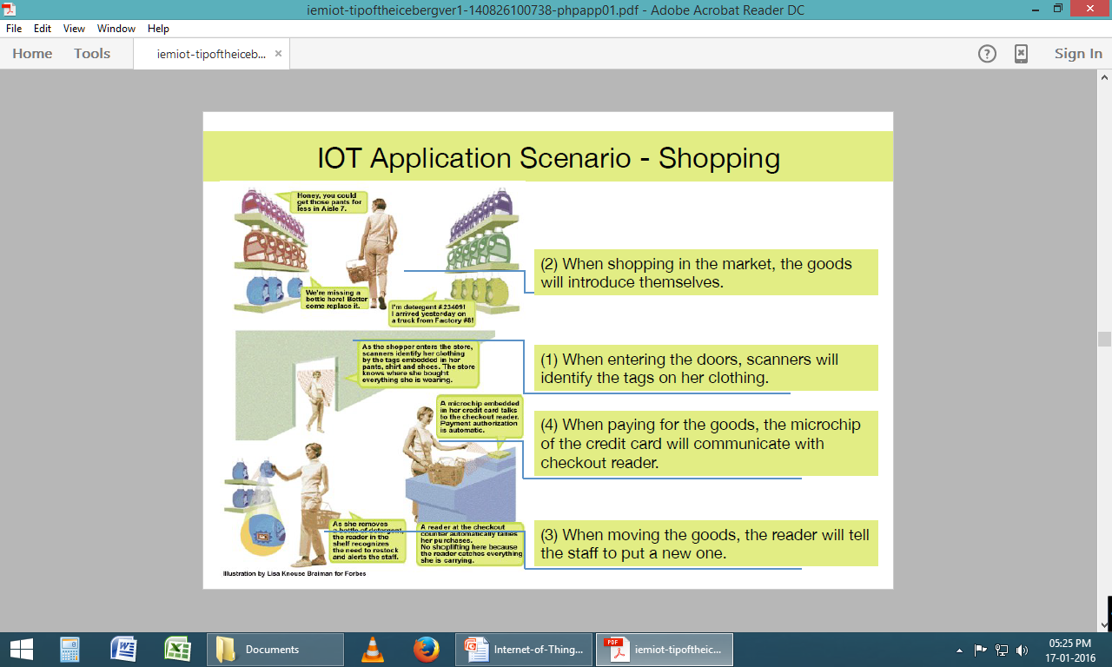
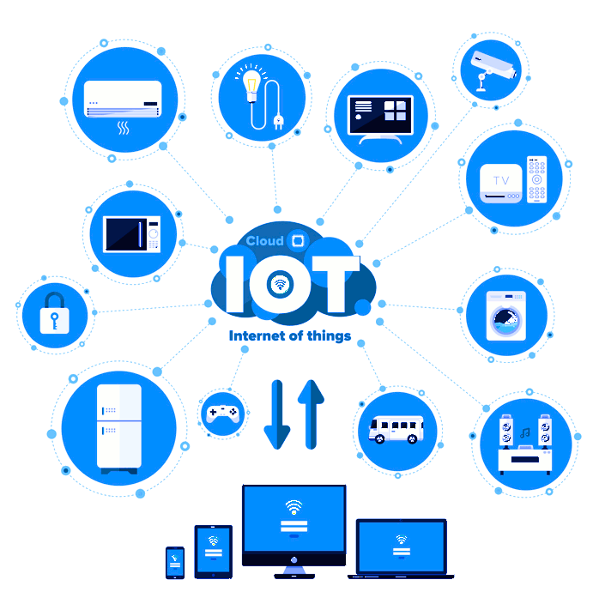
IoT Applications
Smart Thermostats
Connected Cars
Activity Trackers
Parking Sensors
Connect Health
Smart City

Slide 22
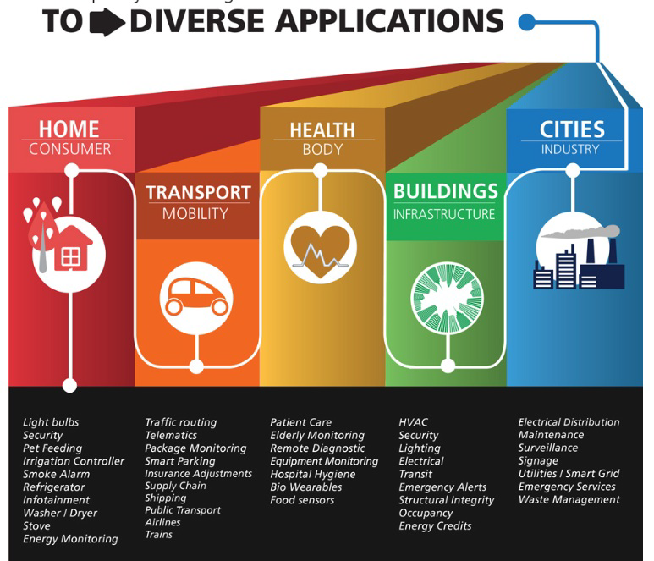
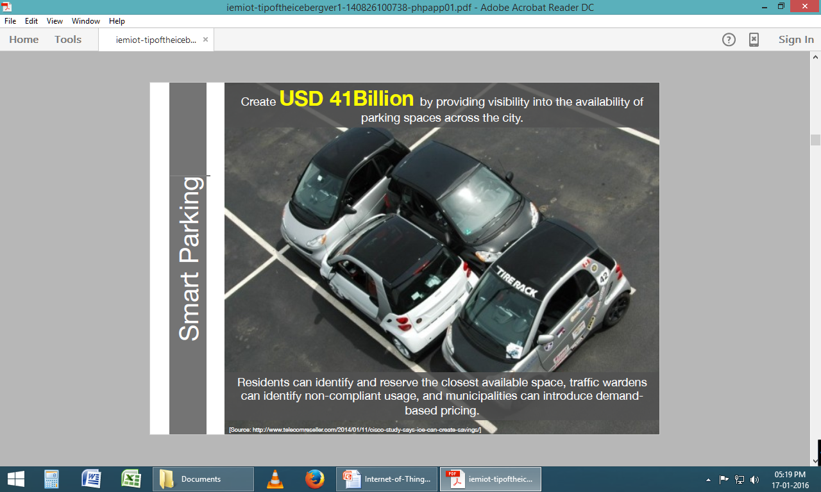
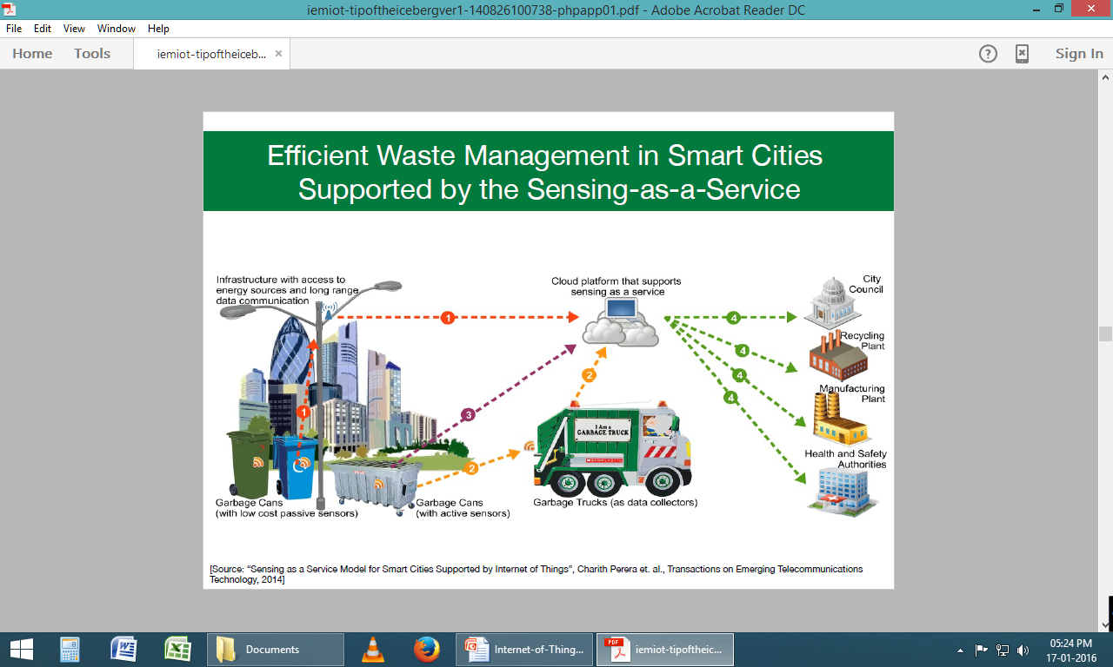

Slide 23
Challenges of Internet of Things (IoT)
Insufficient testing and updating
Concern regarding data security and privacy
Software complexity
Data volumes and interpretation
Integration with AI and automation
Devices require a constant power supply which is difficult
Interaction and short-range communication

Slide 24
Advantages of IoT
Ability to access information from anywhere at any time on any device;
Improved communication between connected electronic devices;
Transferring data packets over a connected network saving time and money; and
Automating tasks helping to improve the quality of a business's services and reducing the need for human intervention.

Slide 25
Disadvantages IoT
As the number of connected devices increases and more information is shared between devices, the potential that a hacker could steal confidential information also increases.
Enterprises may eventually have to deal with massive numbers -- maybe even millions -- of IoT devices, and collecting and managing the data from all those devices will be challenging.
If there's a bug in the system, it's likely that every connected device will become corrupted.
Since there's no international standard of compatibility for IoT, it's difficult for devices from different manufacturers to communicate with each other.

Slide 26
Physical Design of IoT
The "Things" in IoT usually refers to IoT devices which have unique identities and can perform remote sensing, actuating and monitoring capabilities.
IoT devices can:
Exchange data with other connected devices and applications (directly or indirectly), or
Collect data from other devices and process the data locally or
Send the data to centralized servers or cloud-based application back-ends for processing the data, or
Perform some tasks locally and other tasks within the IoT infrastructure, based on temporal and space constraints

Slide 27
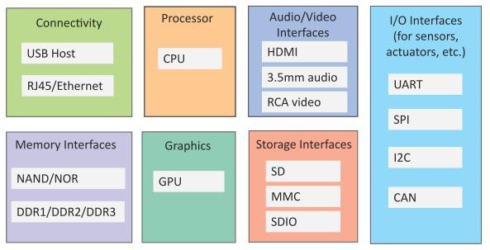
Generic block diagram of an IoT Device
“Physical” components / capabilities – Sensors / Actuators – Compute, store, communicate data
An IoT device may consist of several interfaces for connections to other devices, both wired and wireless.
I/O interfaces for sensors
Interfaces for Internet connectivity
Memory and storage interfaces
Audio/video interfaces.

Slide 28
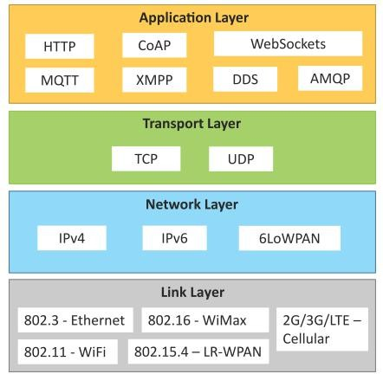
IoT Protocols
Link Layer
802.3 – Ethernet
802.11 – WiFi
802.16 – WiMax
802.15.4 – LR-WPAN
2G/3G/4G
Network/Internet Layer
IPv4
IPv6
6LoWPAN
Transport Layer
TCP
UDP
Application Layer
HTTP
CoAP
WebSocket
MQTT
XMPP
DDS
AMQP

Slide 29
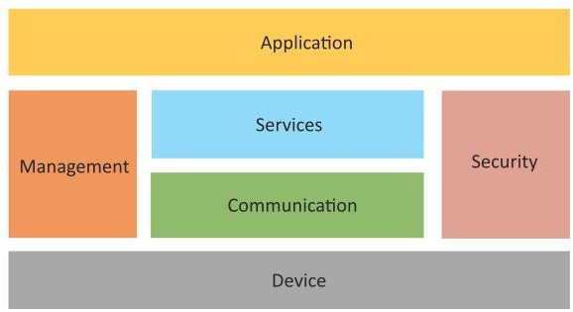
Logical Design of IoT
Logical design of an IoT system refers to an abstract representation of the entities and processes without going into the low-level specifics of the implementation.
An IoT system comprises of a number of functional blocks that provide the system the capabilities for identification, sensing, actuation, communication, and management.

Slide 30
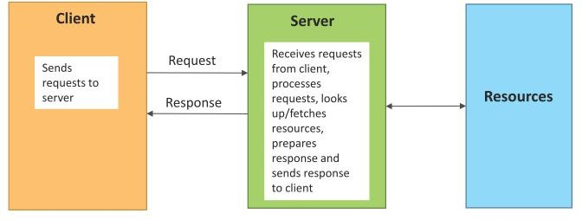
Request-Response communication model
Request-Response is a communication model in which the client sends requests to the server and the server responds to the requests.
When the server receives a request, it decides how to respond, fetches the data, retrieves resource representations, prepares the response, and then sends the response to the client.

Slide 31
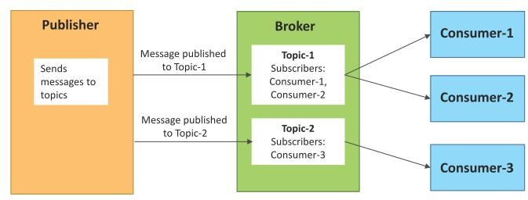
Publish-Subscribe communication model
Publish-Subscribe is a communication model that involves publishers, brokers and consumers.
Publishers are the source of data. Publishers send the data to the topics which are managed by the broker. Publishers are not aware of the consumers.
Consumers subscribe to the topics which are managed by the broker.
When the broker receives data for a topic from the publisher, it sends the data to all the subscribed consumers.

Slide 32
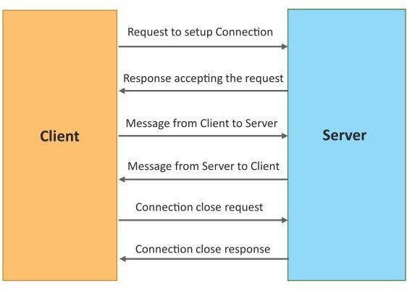
Exclusive Pair communication model
Exclusive Pair is a bidirectional, fully duplex communication model that uses a persistent connection between the client and server.
Once the connection is setup it remains open until the client sends a request to close the connection.
Client and server can send messages to each other after connection setup.

Slide 33
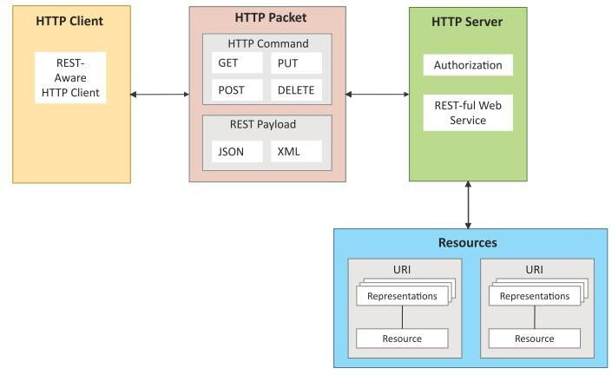
REST-based Communication APIs
Representational State Transfer (REST) is a set of architectural principles by which you can design web services and web APIs that focus on a system’s resources and how resource states are addressed and transferred.
REST APIs follow the request- response communication model.
The REST architectural constraints apply to the components, connectors, and data elements, within a distributed hypermedia system.

Slide 34
IoT Levels & Deployment Templates
An IoT system comprises of the following components:
Device: An IoT device allows identification, remote sensing, actuating and remote monitoring capabilities.
Resource: Resources are software components on the IoT device for accessing, processing, and storing sensor information, or controlling actuators connected to the device. Resources also include the software components that enable network access for the device.
Controller Service: Controller service is a native service that runs on the device and interacts with the web services. Controller service sends data from the device to the web service and receives commands from the application (via web services) for controlling the device.

Slide 35
IoT Levels & Deployment Templates
Database: Database can be either local or in the cloud and stores the data generated by the IoT device.
Web Service: Web services serve as a link between the IoT device, application, database and analysis components. Web service can be either implemented using HTTP and REST principles (REST service) or using WebSocket protocol (WebSocket service).
Analysis Component: The Analysis Component is responsible for analyzing the IoT data and generate results in a form which are easy for the user to understand.
Application: IoT applications provide an interface that the users can use to control and monitor various aspects of the IoT system. Applications also allow users to view the system status and view the processed data.

Slide 36
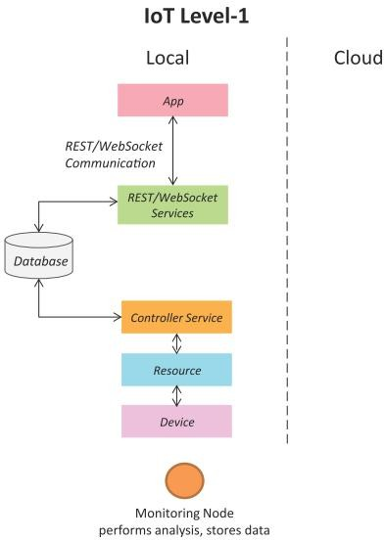
IoT Level-1
A level-1 IoT system has a single node/device that performs sensing and/or actuation, stores data, performs analysis and hosts the application
Level-1 IoT systems are suitable for modeling low- cost and low-complexity solutions where the data involved is not big and the analysis requirements are not computationally intensive.

Slide 37
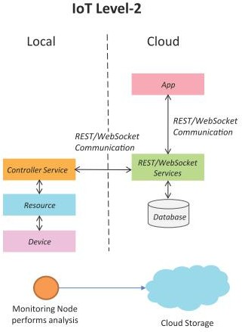
IoT Level-2
A level-2 IoT system has a single node that performs sensing and/or actuation and local analysis.
Data is stored in the cloud and application is usually cloud- based.
Level-2 IoT systems are suitable for solutions where the data involved is big, however, the primary analysis requirement is not computationally intensive and can be done locally itself.

Slide 38
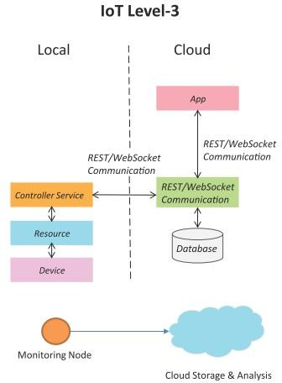
IoT Level-3
A level-3 IoT system has a single node. Data is stored and analyzed in the cloud and application is cloud- based.
Level-3 IoT systems are suitable for solutions where the data involved is big and the analysis requirements are computationally intensive.

Slide 39
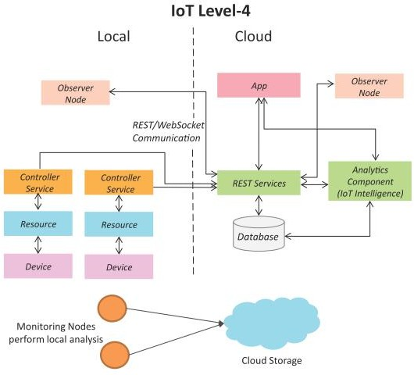
IoT Level-4
A level-4 IoT system has multiple nodes that perform local analysis. Data is stored in the cloud and application is cloud-based.
Level-4 contains local and cloud- based observer nodes which can subscribe to and receive information collected in the cloud from IoT devices.
Level-4 IoT systems are suitable for solutions where multiple nodes are required, the data involved is big and the analysis requirements are computationally intensive.

Slide 40
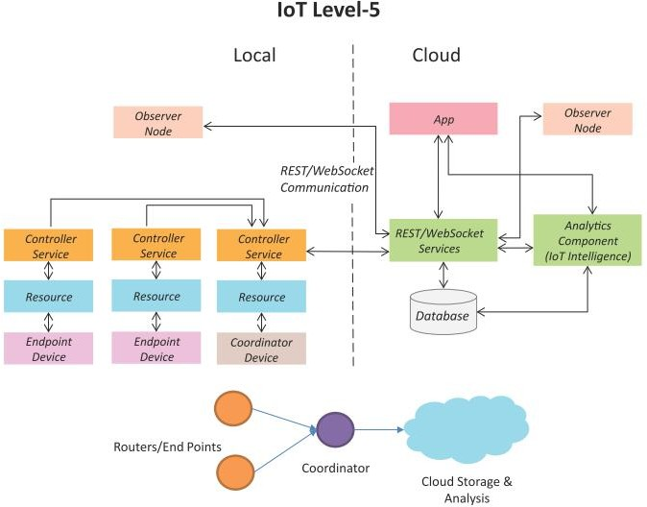
IoT Level-5
A level-5 IoT system has multiple end nodes and one coordinator node.
The end nodes that perform sensing and/or actuation.
Coordinator node collects data from the end nodes and sends to the cloud.
Data is stored and analyzed in the cloud and application is cloud-based.
Level-5 IoT systems are suitable for solutions based on wireless sensor networks, in which the data involved is big and the analysis requirements are computationally intensive.

Slide 41
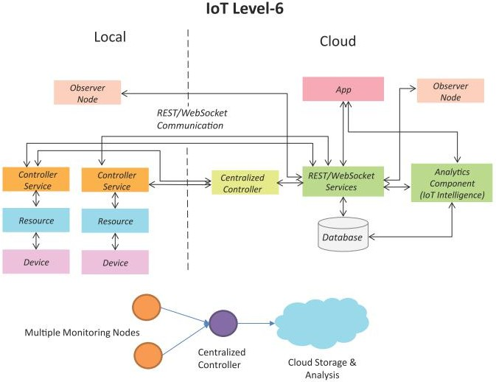
IoT Level-6
A level-6 IoT system has multiple independent end nodes that perform sensing and/or actuation and send data to the cloud.
Data is stored in the cloud and application is cloud-based.
The analytics component analyzes the data and stores the results in the cloud database.
The results are visualized with the cloud-based application.
The centralized controller is aware of the status of all the end nodes and sends control commands to the nodes.

Slide 42
IoT(internet of things) enabling technologies:
Wireless Sensor Network
Cloud Computing
Big Data Analytics
Communications Protocols
Embedded System
1. Wireless Sensor Network(WSN) : A WSN comprises distributed devices with sensors which are used to monitor the environmental and physical conditions. A wireless sensor network consists of end nodes, routers and coordinators. End nodes have several sensors attached to them where the data is passed to a coordinator with the help of routers. The coordinator also acts as the gateway that connects WSN to the internet. Example –
Weather monitoring system
Indoor air quality monitoring system
Soil moisture monitoring system
Surveillance system
Health monitoring system

Slide 43
2. Cloud Computing : It provides us the means by which we can access applications as utilities over the internet. Cloud means something which is present in remote locations. With Cloud computing, users can access any resources from anywhere like databases, webservers, storage, any device, and any software over the internet. Characteristics –
Broad network access
On demand self-services
Rapid scalability
Measured service
Pay-per-use
3. Big Data Analytics : It refers to the method of studying massive volumes of data or big data. Collection of data whose volume, velocity or variety is simply too massive and tough to store, control, process and examine the data using traditional databases. Big data is gathered from a variety of sources including social network videos, digital images, sensors and sales transaction records. Several steps involved in analyzing big data –
Data cleaning
Munging
Processing
Visualization
Examples –
Bank transactions
Data generated by IoT systems for location and tracking of vehicles
E-commerce and in Big-Basket
Health and fitness data generated by IoT system such as a fitness bands

Slide 44
4. Communications Protocols : They are the backbone of IoT systems and enable network connectivity and linking to applications. Communication protocols allow devices to exchange data over the network. Multiple protocols often describe different aspects of a single communication. A group of protocols designed to work together is known as a protocol suite; when implemented in software they are a protocol stack.
5. Embedded Systems : It is a combination of hardware and software used to perform special tasks. It includes microcontroller and microprocessor memory, networking units (Ethernet Wi-Fi adapters), input output units (display keyword etc. ) and storage devices (flash memory). It collects the data and sends it to the internet. Embedded systems used in Examples –
Digital camera
DVD player, music player
Industrial robots
Wireless Routers etc.

Slide 45
Top 10 Strategic IoT Technologies and Trends - GARTNER
Trend No. 1: Artificial Intelligence (AI): “Data is the fuel that powers the IoT and the organization’s ability to derive meaning from it will define their long term success.”
Trend No. 2: Social, Legal and Ethical IoT: These include ownership of data and the deductions made from it, algorithmic bias, privacy and compliance with regulations such as the General Data Protection Regulation. “Successful deployment of an IoT solution demands that it’s not just technically effective but also socially acceptable.”
Trend No. 3: Infonomics and Data Broking: The theory of infonomics takes monetization of data further by seeing it as a strategic business asset to be recorded in the company accounts. By 2023, the buying and selling of IoT data will become an essential part of many IoT systems.

Slide 46
Top 10 Strategic IoT Technologies and Trends – GARTNER (cont’d)
Trend No. 4: The Shift from Intelligent Edge to Intelligent Mesh: The shift from centralized and cloud to edge architectures is well under way in the IoT space. These mesh architectures will enable more flexible, intelligent and responsive IoT systems — although often at the cost of additional complexities.
Trend No. 5: IoT Governance: As the IoT continues to expand, the need for a governance framework that ensures appropriate behaviour in the creation, storage, use and deletion of information related to IoT projects will become increasingly important.
Trend No. 6: Sensor Innovation: The sensor market will evolve continuously through 2023. New sensors will enable a wider range of situations and events to be detected.

Slide 47
Top 10 Strategic IoT Technologies and Trends – GARTNER (cont’d)
Trend No. 7: Trusted Hardware and Operating System: ‘.. by 2023, we expect to see the deployment of hardware and software combinations that together create more trustworthy and secure IoT systems…’.
Trend 8: Novel IoT User Experiences: User experience driven by 4 factors: new sensors, new algorithms, new experience architectures and context, and socially aware experiences.
Trend No. 9: Silicon Chip Innovation: By 2023, it’s expected that new special-purpose chips will reduce the power consumption required to run IoT devices.
Trend No. 10: New Wireless Networking Technologies for IoT: IoT networking involves balancing a set of competing requirements. In particular they should explore 5G, the forthcoming generation of low earth orbit satellites, and backscatter networks.

